Slide 1

Bank Customers Predictions Using Deep Learning Neural Networks
Ali AL-Hasan
24000014
Rola Yaseen
24000044
Batoul Labban
24000054

Slide 2
Overview Of The Dataset And The Problem:
The dataset include features like credit score, geography, gender, age, balance and activity status. Based on this the problem we are trying to solve is to predict customer churn (exit) in a bank, meaning to predict if they will leave the bank (Exited = 1) or remain (Exited = 0).
Problem Type > Binary Classification.

Slide 3
1.1 EDA: Dataset Overview
Dataset Dimensions: Evaluated a total of 7,000 customer training records across 14 distinct feature attributes.
Irrelevant Feature Removal: Dropped non-predictive administrative identifiers (RowNumber, CustomerId, Surname) to prevent model overfitting and reduce feature noise.
Zero Missing Values: Confirmed 100% data completeness across all continuous and categorical columns with no null or missing records in either training or test sets.
No Duplicate Rows: Verified that no duplicate customer entries existed in the dataset.

Slide 4
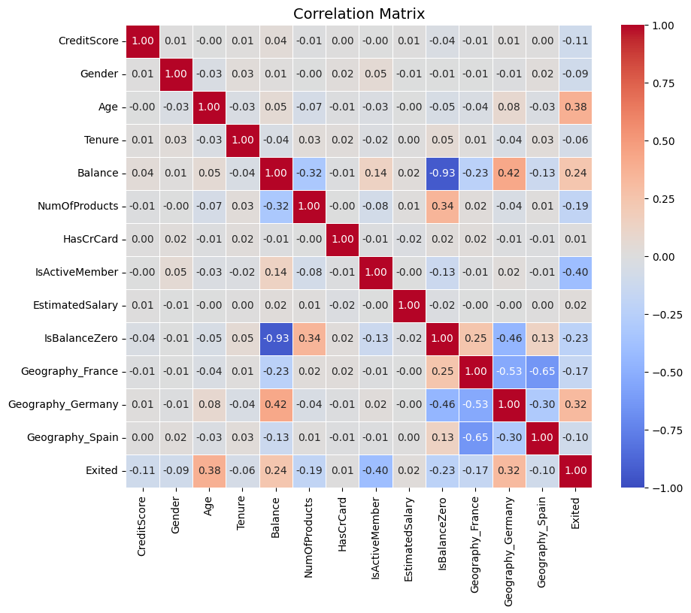
1.1 EDA: Key Data Insights & Characteristics
Target Variable Imbalance: The target variable (Exited) displays a clear class imbalance, with only ~18.1% of customers having churned (1,267 out of 7,000).
Customer Geography: France represents the majority market (~53.3%), followed by Germany and Spain.

Slide 5
1.2 Feature Engineering:
New Feature Creation: Created an IsBalanceZero binary indicator flag to explicitly capture zero vs. non-zero balance behavior.
Categorical Feature Encoding: Applied One-Hot Encoding to Geography, generating distinct binary columns and applied Binary Mapping to Gender (Male =1, Female = 0).
Feature Scaling: Fitted a StandardScaler on the training split to standardize continuous features (CreditScore, Age, Tenure, Balance, NumOfProducts, EstimatedSalary).
Data Organization: Reordered columns to position the target variable (Exited) as the final column and exported the processed datasets.

Slide 6
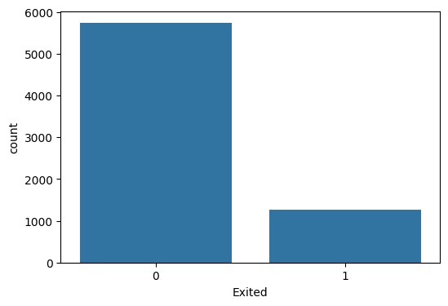
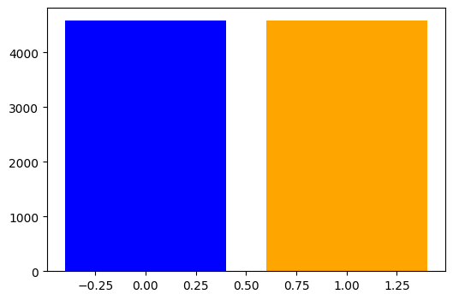
2 Handling Class Imbalance :
Data Splitting: Split the dataset into training and validation sets using stratified sampling, ensuring oversampling techniques were applied strictly to the training set to keep validation data untouched and prevent data leakage.
Synthetic Oversampling: Addressed the class imbalance using SMOTE, bringing the minority class up to match the majority class at exactly 4,586 samples per class in the training set.

Slide 7
3.1 Building the Neural Network:
Structure: A multi-layer perceptron with input layer sized 13 for 13 features and 3 Hidden layers with 64,32,16 neurons respectively.
Activation Function: ReLU is used after each hidder layer to introduce non-linearity.
Output Layer: A single neuron with a Sigmoid activation function to output a probability between 0 and 1, representing the customer churning probability.
Regularization & Optimization: The model uses Batch Normalization for stable training, Dropout (rates of 20% and 30%) to prevent overfitting, Binary Cross-Entropy Loss for binary classification, and the Adam optimizer with a learning rate of 0.001.

Slide 8
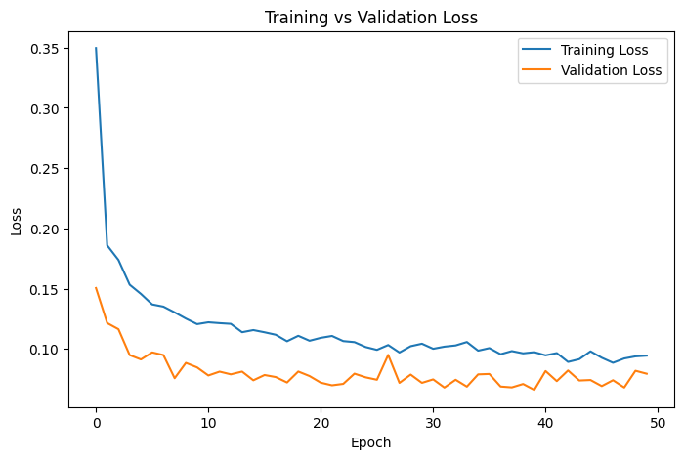
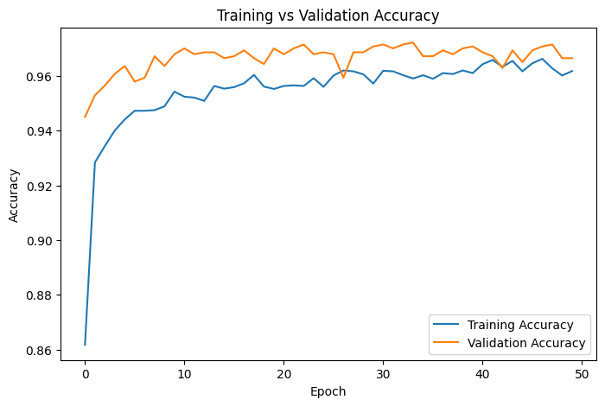
3.2 Training The Model:
The model was trained for 50 epochs to allow it to learn the complex patterns in the data.
- Training/Validation Performance:
The training process was stable, with the model showing strong performance on both training and validation sets. The validation accuracy quickly converged to a high level, indicating that the model was learning effectively without significant overfitting.
- Training Accuracy: Reached ~96.4%
- Validation Accuracy: Reached ~97.1%

Slide 9
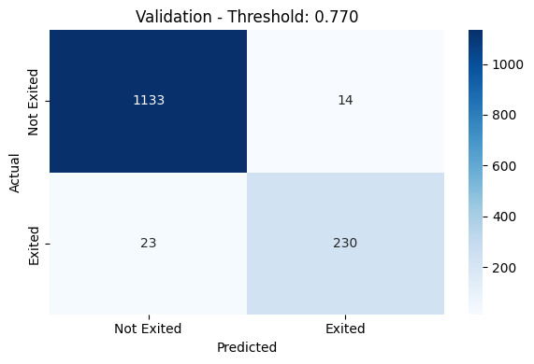
3.3 Evaluating The Model:
After training, we evaluated the final model's performance on the hold-out validation set to get an unbiased estimate of its generalization capabilities.
- Performance Metrics:
ROC-AUC Score: 99%.
Accuracy: 97.36%.
F1-Score: 0.9256.

Slide 10
3.4 Prediction the Testing Dataset:
- Final Submission:
The final model was used to make predictions on the unseen test dataset.
The model's output (probability) was converted to a binary prediction (0 or 1) using the optimized threshold.

